Slide 1
Microprocessors and Assembly Language Lecture 24 Hamed Farbeh farbeh@aut.ac.ir Spring 2023

Slide 2
Copyright Notice
Parts (text & figures) of this lecture are adopted from:
Arm Assembly Language Programming and Architecture, Volume 1, 1st edition, Muhammad Ali Mazidi, Sarmad Naimi, and Sepehr Naimi, MicroDigitalEd, 2013

Slide 3
Appendix C: Macros

Slide 4
Macro
Write the task once and invoke it whenever it is needed
MACRO definition:
MACRO [$label] macro Name parameter 1, parameter 2, ..., parameter N ...
… MEND
MACRO ADD3VAL $DEST, $ARG1, $ARG2, $ARG3 ADD $DEST, $ARG1, $ARG2 ADD $DEST, $DEST, $ARG3 MEND
To distinguish parameters, they must start with $
AREA CODE1, READONLY, CODE MOV R1, #5 MOV R2, #2 ADD3VAL R0, R1, R2, #5

Slide 5
Macro
Default Values for parameters
MACRO ADD3VAL $DEST, $ARG1=R3, $ARG2, $ARG3=#5 ADD $DEST, $ARG1, $ARG2 ADD $DEST, $DEST, $ARG3 MEND
To use the default value, put a ‘|’ instead of the parameter
ADD3VAL R0, R1, R2, |

Slide 6

Using Labels in Macros
Labels must be unique
MACRO
$lbl OUR_MACRO
CMP R1,#5
BEQ $lbl
MOV R1, #1
$lbl
MEND
AREA OURCODE, READONLY, CODE ENTRY
MOV R1, #3
Label1 OUR_MACRO
MOV R1, #5
Label2 OUR_MACRO
HERE B HERE

Slide 7
Using Labels in Macros
MACRO
$lbl OUR_MACRO
CMP R1, #5
BEQ $lbl.equal
MOV R1, #1
B $lbl.next
$lbl.equal
MOV R1, #2
$lbl.next
MEND
AREA OURCODE, READONLY, CODE
MOV R1, #3
label1 OUR_MACRO
MOV R1, #5
label2 OUR_MACRO
HERE B HERE
MOV R1, #3
CMP R1, #5
BEQ label1equal
MOV R1, #1 B label1next label1equal MOV R1, #2 label1next MOV R1, #5
CMP R1, #5
BEQ label2equal
MOV R1, #1
B label2next label2equal MOV R1, #2 label2next HERE B HERE
Multiple Labels in Macros

Slide 8
Conditional Macros
We can pass condition into macros
MACRO
$lbl OurMacro$cond
CMP R1, #5
B$cond $lbl.equal
MOV R1, #1
$lbl.equal
MEND
AREA OURCODE, READONLY, CODE
MOV R1, #3
label1 OurMacroEQ ; in the macro check equality
MOV R1, #3
label2 OurMacroLO ; in the macro check if is lower
HERE B HERE
MOV R1, #3
label1 OurMacroEQ
CMP R1, #5
BEQ label1equal
MOV R1, #1
label1equal
MOV R1, #3
label2 OurMacroLO
CMP R1, #5
BLO label2equal
MOV R1, #1 label2equal HERE B HERE

Slide 9
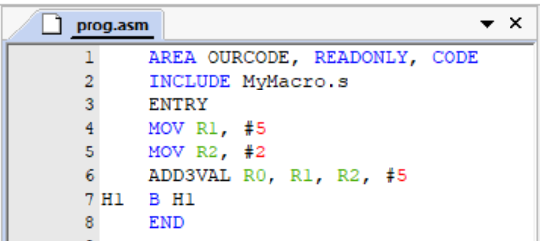
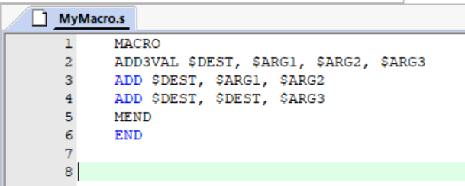
MACRO from Files
Include Directives

Slide 10
Question
Write a subroutine that clears the R0th bit of the memory address in R1
void bit_clear(int n, int *num);
Hint: Use the BIC instruction
BIC Rd, Rn, Op2; Rd = Rn & (!Op2)
If you change the BIC instruction in your code with EOR, you’ll get a subroutine that changes the R0th bit, instead of clearing it. Turn your code into a macro and implement both functions with it.

Slide 11
Question (cont.)
The technique you just used is used in the Linux Kernel to implement change_bit and clear_bit functions.
https://github.com/torvalds/linux/blob/master/arch/arm/lib/clearbit.S
https://github.com/torvalds/linux/blob/master/arch/arm/lib/changebit.S
https://github.com/torvalds/linux/blob/master/arch/arm/lib/bitops.h

Slide 12
End of Appendix C!

